Slide 1
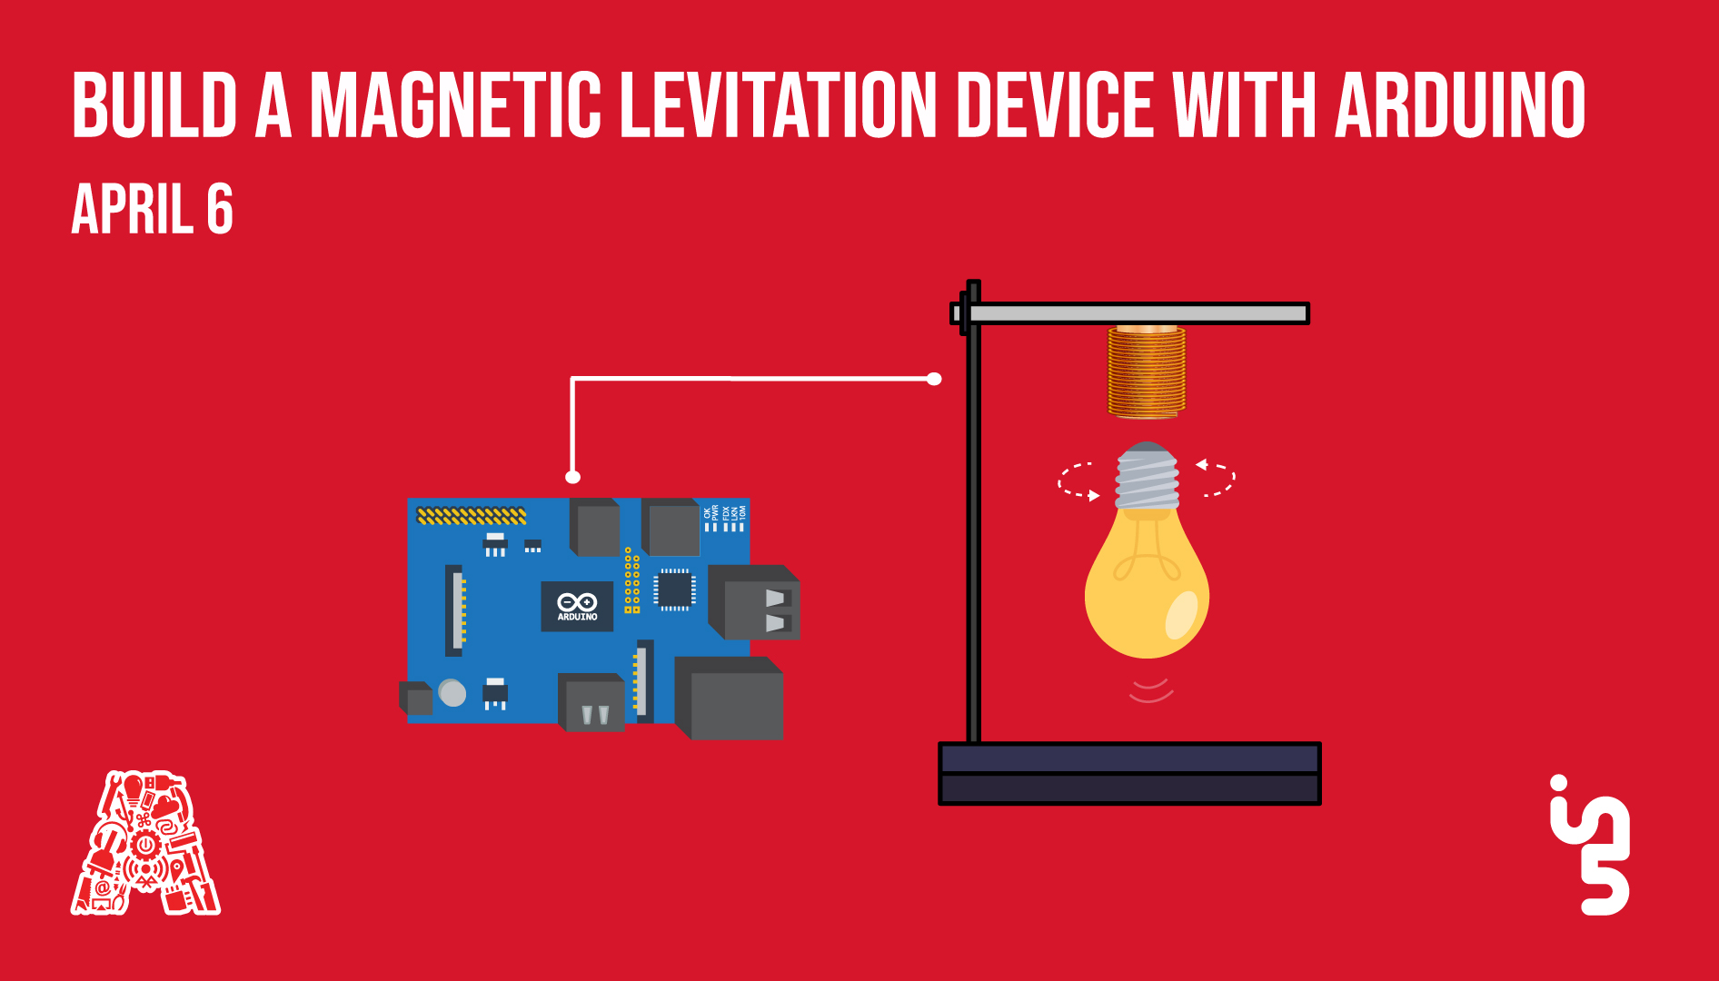

Slide 2
About the Assembly
A smart lab based out of In5 since Dec 2014
Over 200 free workshops done
ASSEMBLY: HACK - Embedded systems, iOT and hardware
ASSEMBLY: CODE - Software projects - APIs, frameworks, apps
Age range: 16-60 - students, professionals, entrepreneurs
Focus on smart technology and practical applications
Forum: members.theassembly.ae

Slide 3
TAG US ON OUR SOCIAL MEDIA
FACEBOOK
TWITTER
INSTAGRAM
YOUTUBE
The Assembly (@MakeSmartThings)
@MakeSmartThings
@MakeSmartThings
The Assembly

Slide 4
Agenda
Magnetic Levitation - What is it?
Real life applications
The design
Components
Neodymium magnets
Arduino UNO
Transistor
Electromagnet
Linear hall effect sensor
How it Works
Arduino IDE Code
Without PID
With PID

Slide 5
Magnetic Levitation

Slide 6
Real life applications
Maglev transportation
Levitation melting
Toys

Slide 7
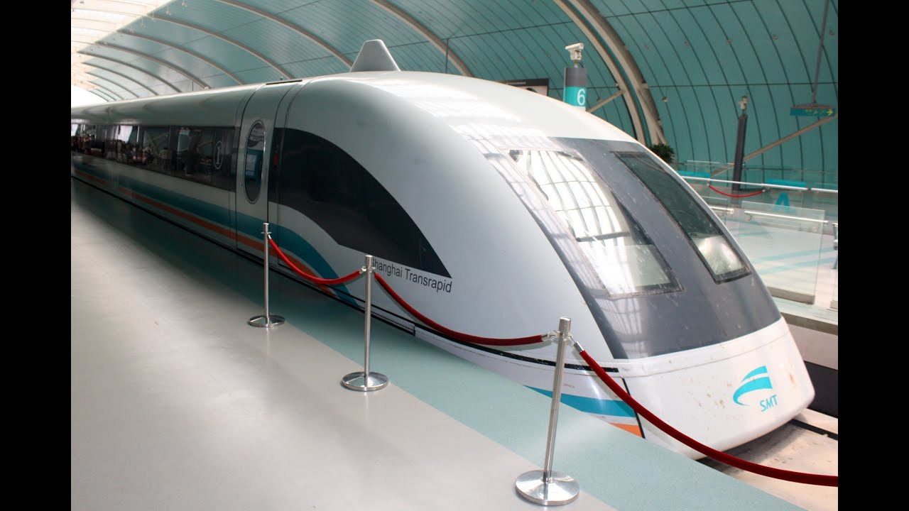
Shanghai
Maglev
Fastest Commercial train in the world!

Slide 8
Top Speed: 431 km/h (267 mph)
Reaches 354 km/h in 2 minutes
Cost: 546 million AED over 2.5 years
30.5 km long track
Takes 7 min & 20 seconds to complete journey
Uses magnetic levitation!

Slide 9

Dubai metro only has a max of 90 km/h and takes 2.4 hrs to finish 75 km (red line)
It’s slower

Slide 10


Slide 11
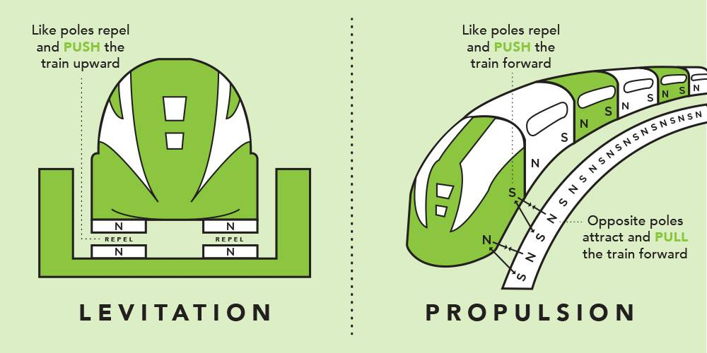
The magnets are superconducting, when cooled to less than 450 degree below zero, they generate magnetic fields strong enough to suspend and propel a train

Slide 12

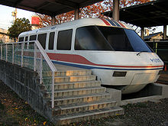

1. USA (2013 – present) Train: Hyperloop project Speed: 1,200 km/h – 745 mph Capacity: Experimental
2. Japan (2002 – present) Train: JR-Maglev MLX01 Speed: 581 km/h – 361 mph Capacity: Experimental
3. France (2000 – 2007) Train: TGV V150 Speed: 574 km/h – 357 mph Capacity: Experimental
4. Germany (1987 – 2012) Train: Transrapid TR-07 Speed: 434 km/h – 270.3 mph Capacity: Experimental

Slide 13
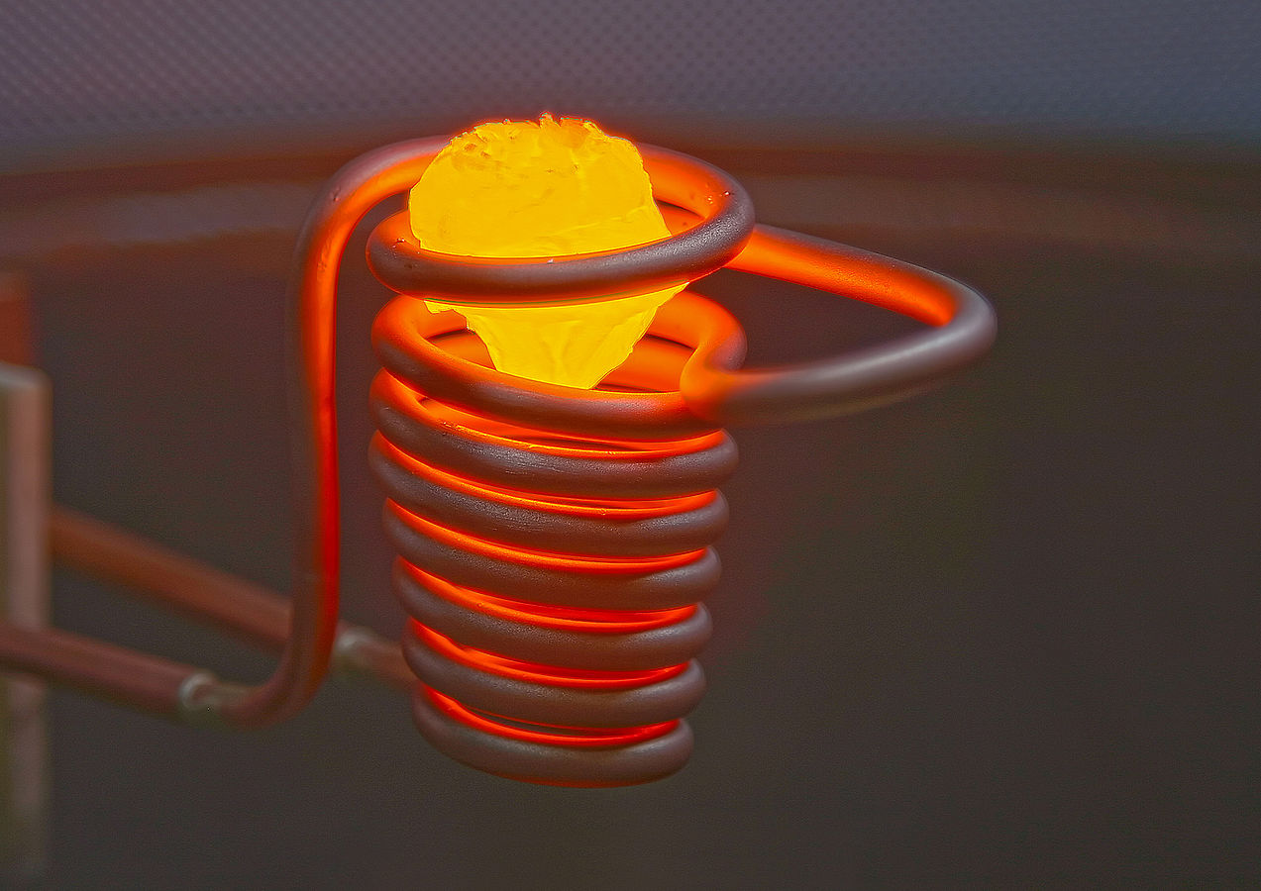
Levitation melting
Notes:
With levitation melting, induction energy creates a force strong enough within theinduction coil to allow to counter gravity. The metal part remains in the inductionfield and heats until it has melted. Levitation melting is ideal for industries that need pure samples, without potential contamination from a crucible.

Slide 14
Video Link:
https://www.youtube.com/watch?v=VydPQuLyEns

Slide 15
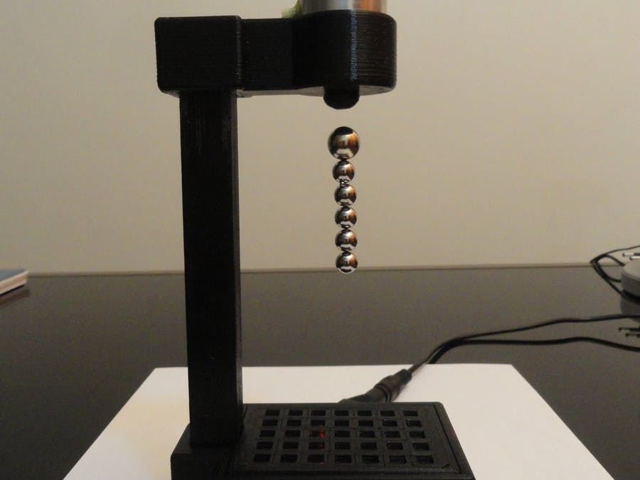
Toys!

Slide 16
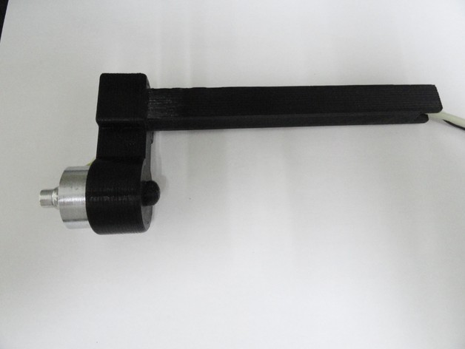
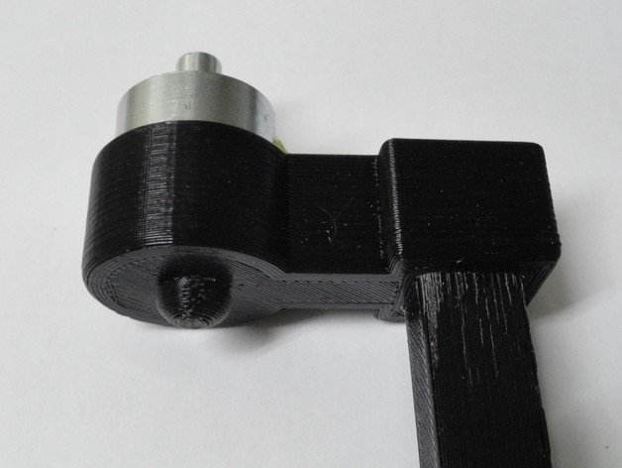
Body Design
Vertical Design
Neck, mount and base are 3D printed
The Electromagnet pole is face down
The Hall effect sensor is placed face down, approximately 5mm from the Electromagnet
Electromagnet
Hall effect Sensor

Slide 17
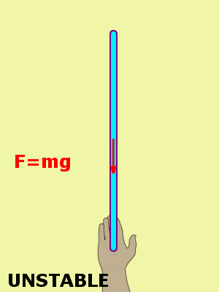
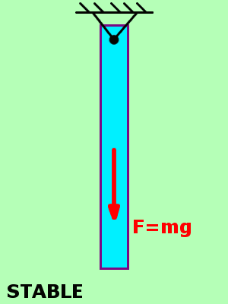
A stick held from the bottom is unstable. Once it starts to tip, gravity will tend to make it tip more. Only by reacting and moving your hand can you hold it upright
A stick held from the top is naturally stable. Push the bottom off-center, and gravity tends to pull it back to the stable position.

Slide 18

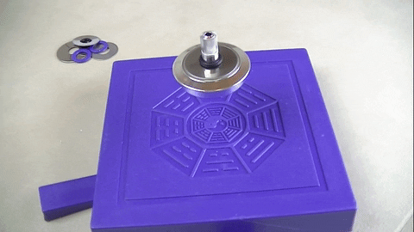
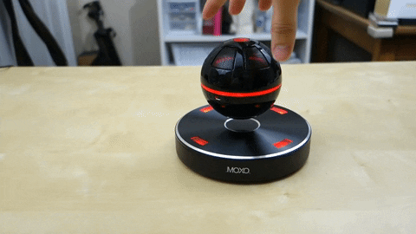
Designs utilizing levitation from the bottom

Slide 19
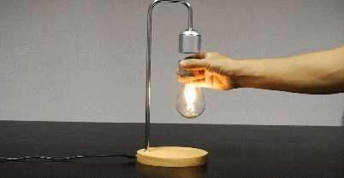
Witchcraft!?

Slide 20
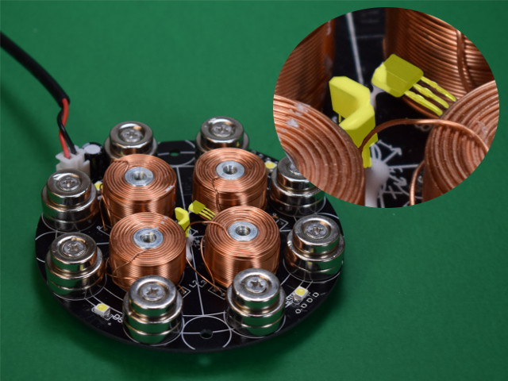
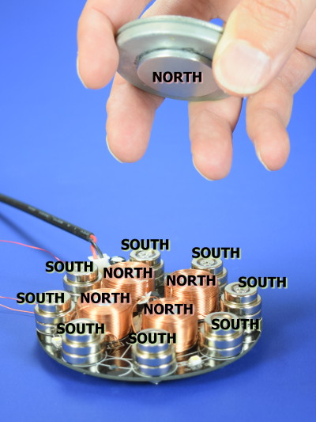
The four copper windings around steel shafts are electromagnets.
Hall effect sensors, highlighted in yellow

Slide 21

How it levitates

Slide 22
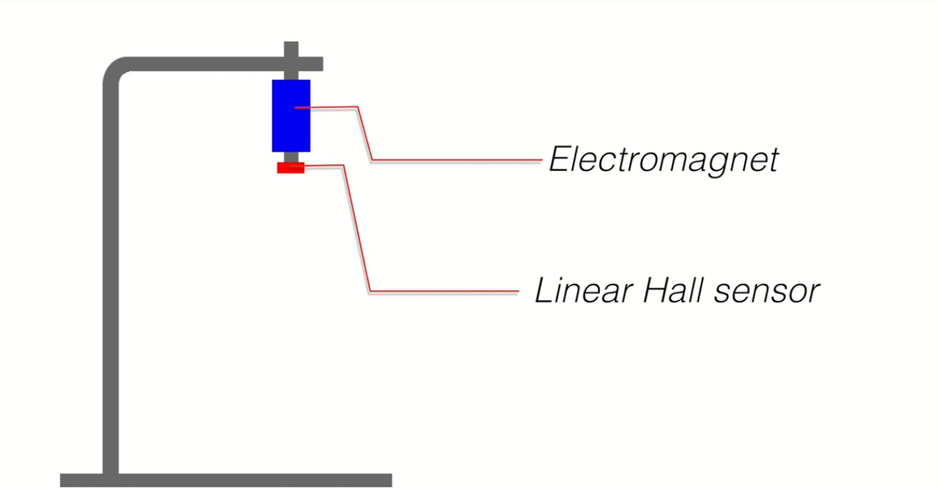

Slide 23
Components

Slide 24
Neodymium magnets
Arduino UNO
Transistor
Electromagnet
Linear hall effect sensor

Slide 25
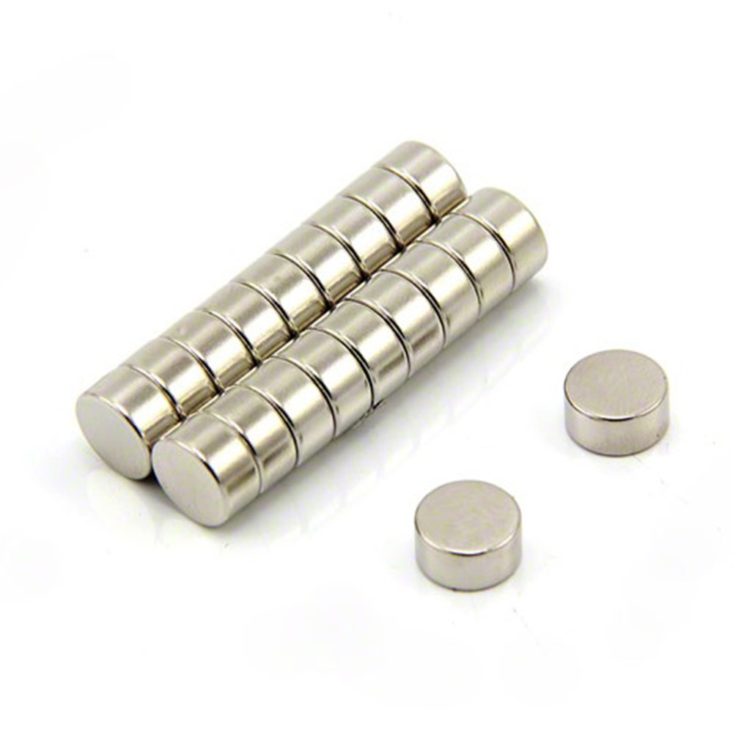
Neodymium magnets (NdFeB or Neo magnet)
Rare earth magnet (permanent magnets made from alloys of rare-earth elements)
Strongest permanent magnets commercially available.
Developed independently in 1982 by General Motors and Sumitomo Special Metals,

Slide 26
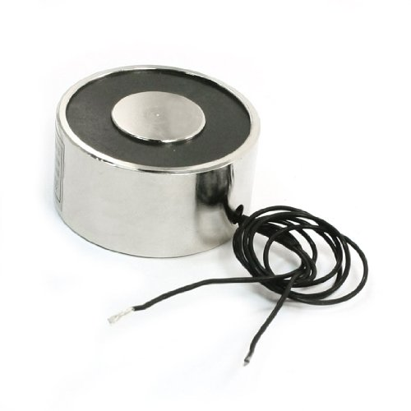
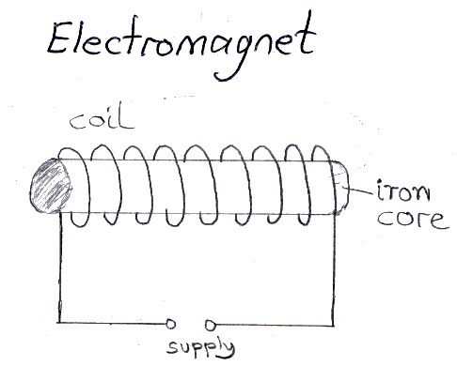
Electromagnet
It is a magnet that runs on electricity. The strength of an electromagnet can easily be changed by changing the amount of electric current that flows through it. The poles of an electromagnet can even be reversed by reversing the flow of electricity.
More turns = stronger magnetic field (flux density)

Slide 27
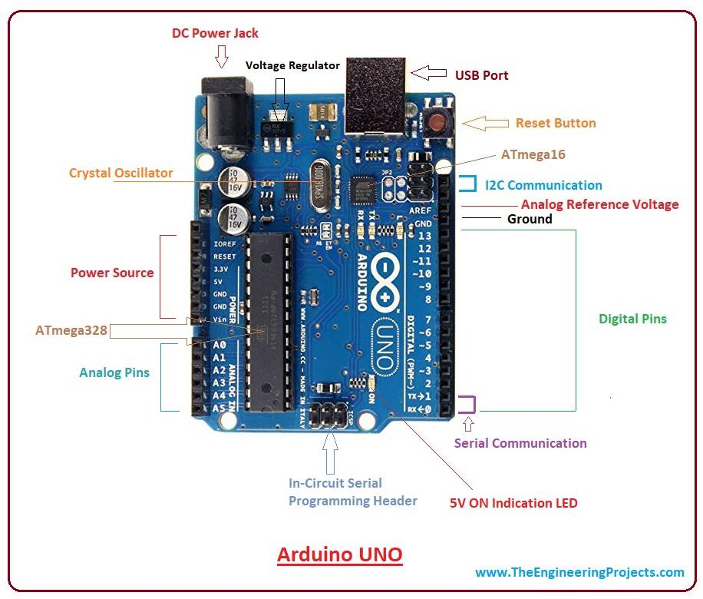
Arduino UNO
Arduino is an open-source platform used for building electronics projects. It consists of both a physical programmable circuit board (a microcontroller) and a piece of software, that runs on your computer.
UNO: 6 analog input pins, 14 I/O digital ports that are used to connect with external electronic circuits. Out of 14 I/O ports, 6 pins can be used for PWM output.

Slide 28
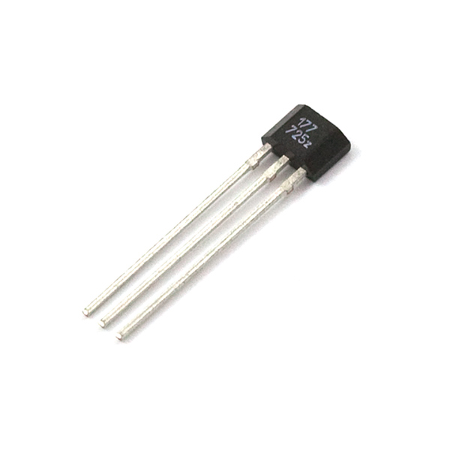
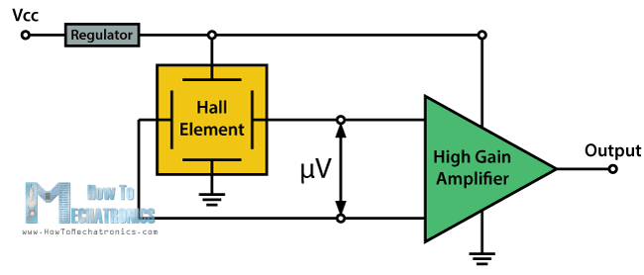
Linear hall effect sensor
Used to measure the magnitude of a magnetic field
output voltage is directly proportional to the magnetic field.
Hall effect sensors are used for proximity sensing, positioning, speed detection, and current sensing applications.

Slide 29
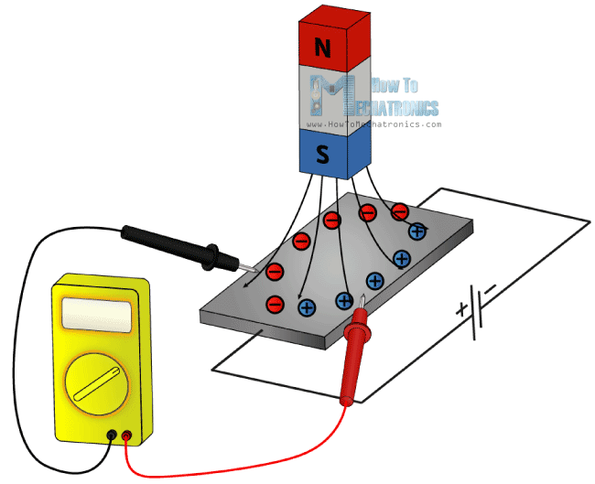
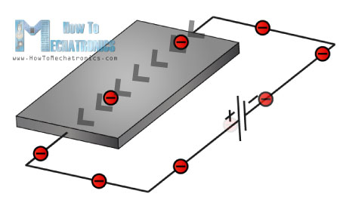
Hall effect

Slide 30
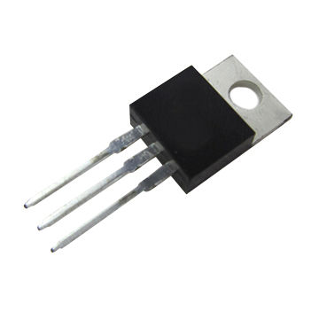
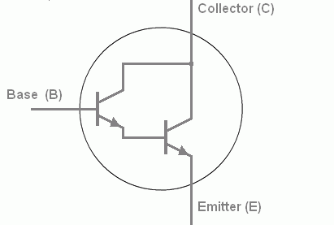
Transistor
Semiconductors able to change from conductor to insulator
Can either allow or prohibit current flow
Uses: amplifiers, switch, voltage regulation, etc.
B
C
E

Slide 31
The Circuit

Slide 32
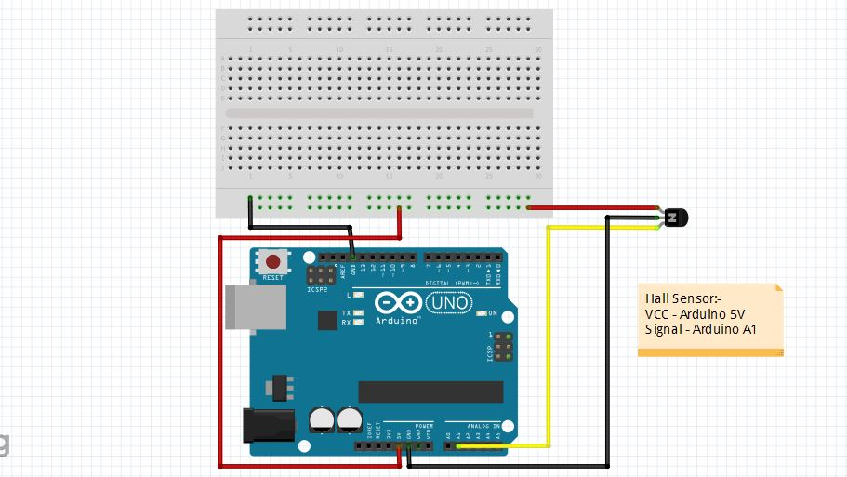
Hall sensor and Arduino Connection

Slide 33
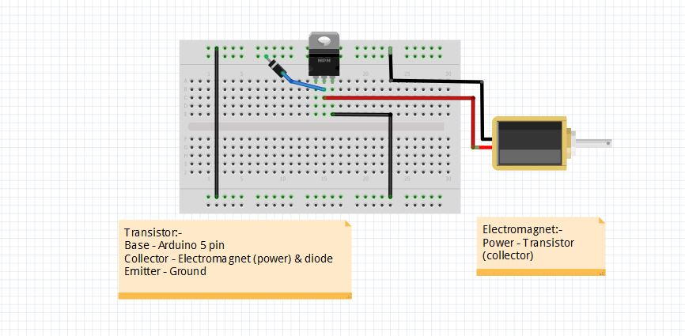
Transistor and Electromagnet

Slide 34
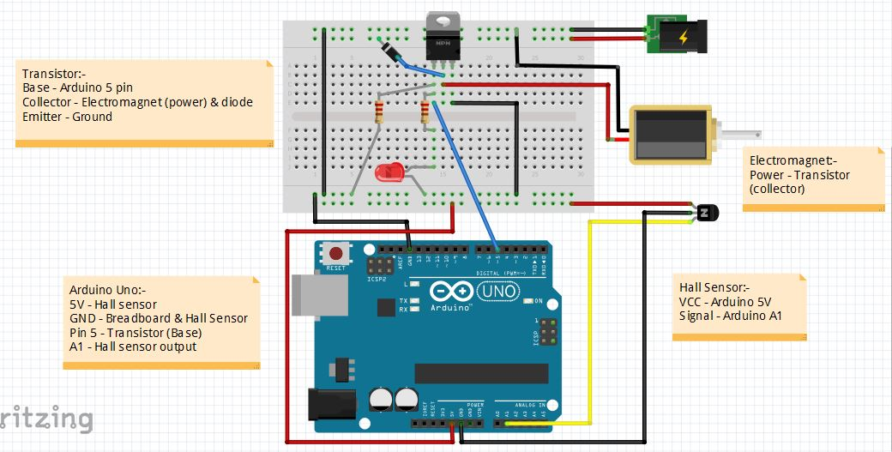

Slide 35
The Code behind it all

Slide 36
Simple If – Else Code
GitHub link - https://github.com/The-Assembly/Magnetic_Levitation
Download file – levitator_ino_workshop.ino
Open it on Arduino IDE and Run it

Slide 37
Fun Challenge
Find the setpoint by youself!
Hint – 300 < x < 400

Slide 38
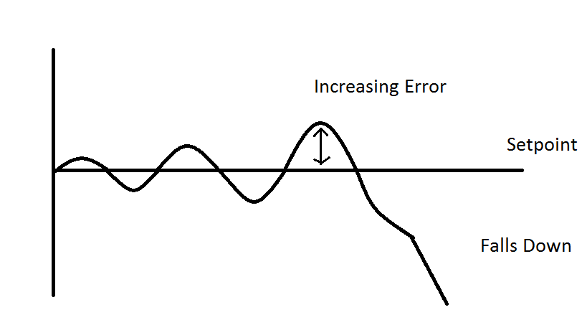
But there is a problem!

Slide 39
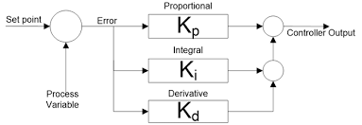
PID Controller

Slide 40
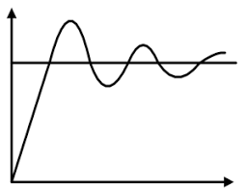

Slide 41
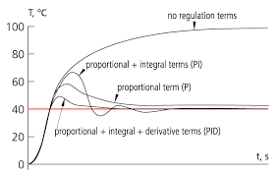
How PID Controller works

Slide 42
Download PID code on GitHub
GitHub link - https://github.com/The-Assembly/Magnetic_Levitation
Download file – levitator_pid_ino.ino
Run in Arduino IDE

Slide 43
PID Tuning Method
Set all values to zero.
Increase the P value until the response to a disturbance is steady oscillation.
Increase the D value until the the oscillations go away (i.e. it's critically damped).
Repeat steps 2 and 3 until increasing the D value does not stop the oscillations.
Set P and D to the last stable values.
Increase the I gain until it brings you to the setpoint with the number of oscillations desired (normally zero)

Slide 44
Fun Challenge
Find PID Values by yourself
Hint:-
0 < Kp < 3
0 < Ki < 0.5
0 < Kd < 0.5

Slide 45
PID Spoiler Alert
Kp = 2
Ki = 0.11
Kd = 0.1

Slide 46

Next workshop teaser - Closing

